Slide 1
HNDIT2302 IT Project Management
Project Integration Management

Slide 2
Project Integration Management
Project Integration Management includes processes required to ensure that the various elements of the project are properly coordinated.
Main processes include:
◦Develop project charter
◦Develop project management plan
◦Direct and manage project execution
◦Monitor and control project work
◦Perform integrated change control
◦Close the project or phase

Slide 3
Project Integration Management Processes
Develop the project charter: Work with stakeholders to create the document that formally authorizes a project—the charter.
Develop the preliminary project scope statement: Work with stakeholders, especially users of the project’s products, services, or results, to develop the high-level scope requirements and create a preliminary project scope statement.
Develop the project management plan: Coordinate all planning efforts to create a consistent, coherent document—the project management plan.

Slide 4
Project Integration Management Processes (cont’d)
Direct and manage project execution: Carry out the project management plan by performing the activities included in it.
Monitor and control the project work: Oversee project work to meet the performance objectives of the project.
Perform integrated change control: Coordinate changes that affect the project’s deliverables and organizational process assets.
Close the project: Finalize all project activities to formally close the project.

Slide 5
Project Integration Management Overview

Slide 6
The Key to Overall Project Success: Good Project Integration Management
Coordinating all of the people, plans, and work required to complete a project
Focus on the big picture of the project and steer the project team toward successful completion
Make final decision when there are conflicts among project goals or people involved
Communicate key project information to top management

Slide 7
Interface Management
Interface management involves identifying and managing the points of interaction between various elements of the project.
The number of interfaces can increase exponentially as the number of people involved in the project increase.
The most important jobs of a project manager is to establish and maintain good communication and relationships across organizational interfaces

Slide 8
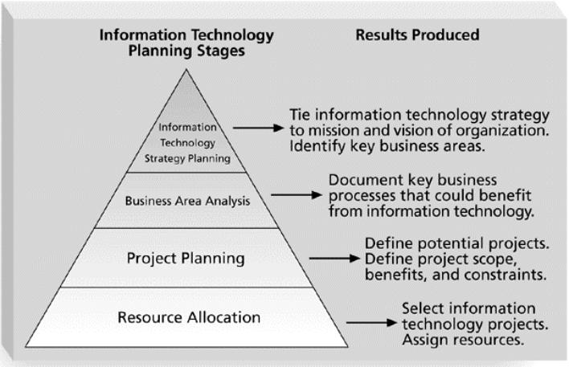
Strategic Planning and Project Selection
Identifying Potential Projects
  Deciding what projects to do in the first place

Slide 9
Strategic Planning and Project
Selection
Strategic planning involves determining long-term objectives, predicting future trends, and projecting the need for new products and services.
Organizations often perform a SWOT analysis:
– Strengths, Weaknesses, Opportunities, and Threats
As part of strategic planning, organizations should:
– Identify potential projects.
– Use realistic methods to select which projects to work on.
– Formalize project initiation by issuing a project ` charter.

Slide 10
Methods for Selecting Projects
There is usually not enough time or resources to implement all projects.
Methods for selecting projects include:
  Focusing on broad organizational needs.
  Categorizing information technology projects.
  Performing net present value or other financial analyses.
  Using a weighted scoring model.
  Implementing a balanced scorecard.

Slide 11
Focusing on Broad
Organizational Needs
It is often difficult to provide strong justification for many IT projects, but everyone agrees they have a high value.
Three important criteria for projects:
  There is a need for the project.
  There are funds available for the project.
  There is a strong will to make the project succeed.

Slide 12
Categorizing IT Projects
One categorization assesses whether the project provides a response to:
  A problem
  An opportunity
  A directive
Another categorization is based on the time it will take to complete a project or the date by which it must be done.
Another categorization is the overall priority of the project.

Slide 13
Financial Analysis of Projects
Financial considerations are often an important aspect of the project selection process.
Three primary methods for determining the projected financial value of projects:
  Net present value (NPV) analysis
  Return on investment (ROI)
  Payback analysis

Slide 14
Net Present Value Analysis
Net present value (NPV) analysis is a method of calculating the expected net monetary gain or loss from a project by discounting all expected future cash inflows and outflows to the present point in time.
Projects with a positive NPV should be considered if financial value is a key criterion.
The higher the NPV, the better.

Slide 15
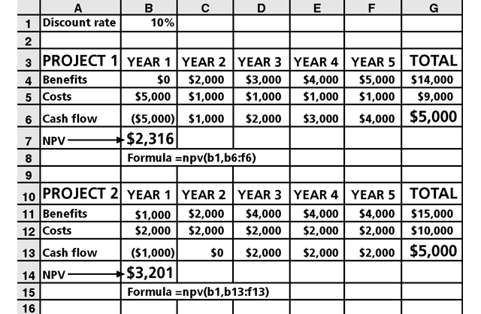
Net Present Value Example
Note that
totals are
equal, but
NPVs are
not because of the time value of money.

Slide 16
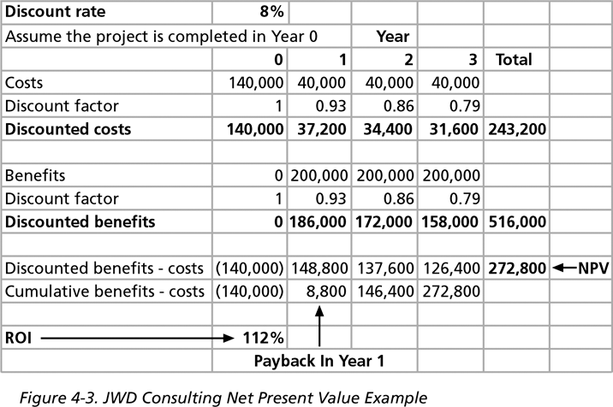
JWD Consulting NPV Example
Multiply
by the
discount
factor each
year, then subtract costs from cumulative
benefits to
get NPV.

Slide 17
NPV Calculations
Determine estimated costs and benefits for the life of the project and the products it produces.
Determine the discount rate (check with your organization on what to use).
Calculate the NPV (see text for details).
Some organizations consider the investment year as year 0, while others consider it year 1. Some people enter costs as negative numbers, while others do not. Make sure to identify your organization’s preferences.

Slide 18
Return on Investment
Return on investment (ROI) is calculated by subtracting the project costs from the benefits and then dividing by the costs.
ROI = (total discounted benefits - total discounted costs) *100 discounted costs
The higher the ROI, the better.
Many organizations have a required rate of return or minimum acceptable rate of return on investment for projects.
Internal rate of return (IRR) can by calculated by setting the NPV to zero.

Slide 19
Payback Analysis
Another important financial consideration is payback analysis.
The payback period is the amount of time it will take to recoup, in the form of net cash inflows, the total dollars invested in a project.
Payback occurs when the cumulative discounted benefits and costs are greater than zero.
Many organizations want IT projects to have a fairly short payback period.

Slide 20
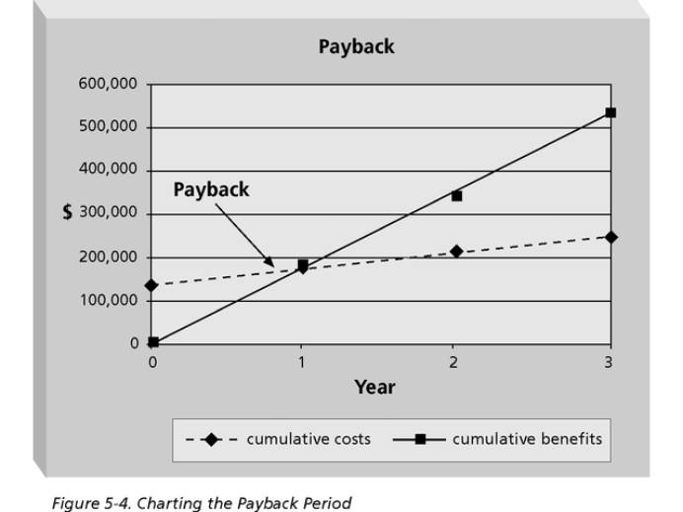
Charting the Payback Period
Excel file

Slide 21
Weighted Scoring Model
A weighted scoring model is a tool that provides a systematic process for selecting projects based on many criteria.
Steps in identifying a weighted scoring model:
    Identify criteria important to the project selection process.
    Assign weights (percentages) to each criterion so they add up to 100 percent.
    Assign scores to each criterion for each project.
    Multiply the scores by the weights to get the total weighted scores.
The higher the weighted score, the better.

Slide 22
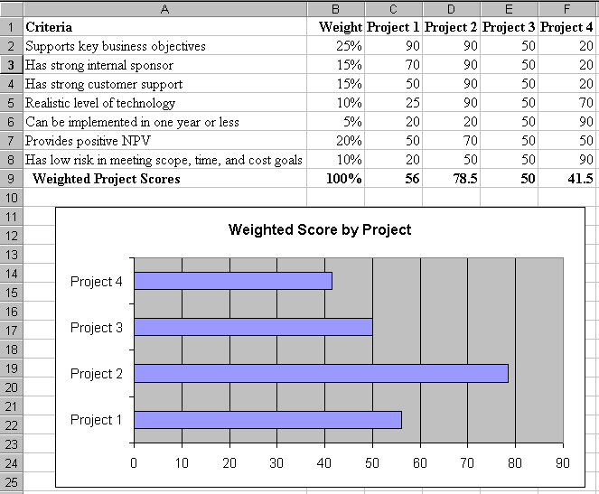
Sample Weighted Scoring Model for Project Selection

Slide 23
Implementing a Balanced Scorecard
Drs. Robert Kaplan and David Norton developed this approach to help select and manage projects that align with business strategy.
A balanced scorecard is a methodology that converts an organization’s value drivers, such as customer service, innovation, operational efficiency, and financial performance, to a series of defined metrics.

Slide 24
Project Charters
A project charter is a document that formally recognizes the existence of a project and provides direction on the project’s objectives and management.
Key project stakeholders should sign a project charter to acknowledge agreement on the need and intent of the project; a signed charter is a key output of project integration management.

Slide 25
Input for Developing a Project Charter
A contract: includes much of the information needed for creating a good project charter
Statement of work: describe business need for the project, summary of the requirements and characteristics of the products or services, and organizational information
Enterprise environmental factors: organization’s structure, culture, infrastructure, human resources, personnel policies, marketplace conditions, stakeholder risk tolerances, industry risk information

Slide 26
Input for Developing a Project Charter
Organizational process assets information: formal and informal plan, policies, procedures, guidelines, information systems, financial systems, management systems, lessons learned, and historical information

Slide 27
Project Charters
The project’s title and date of authorization
The project manager’s name and contact information
A summary schedule, including the planned start and finish dates
A summary of the project’s budget or reference to budgetary documents
A brief description of the project objectives, including the business need or other justification for authorizing the project
A roles and responsibilities matrix
A sign-off section for signatures of key project stakeholders
A comments section in which stakeholders can provide important comments related to the project

Slide 28
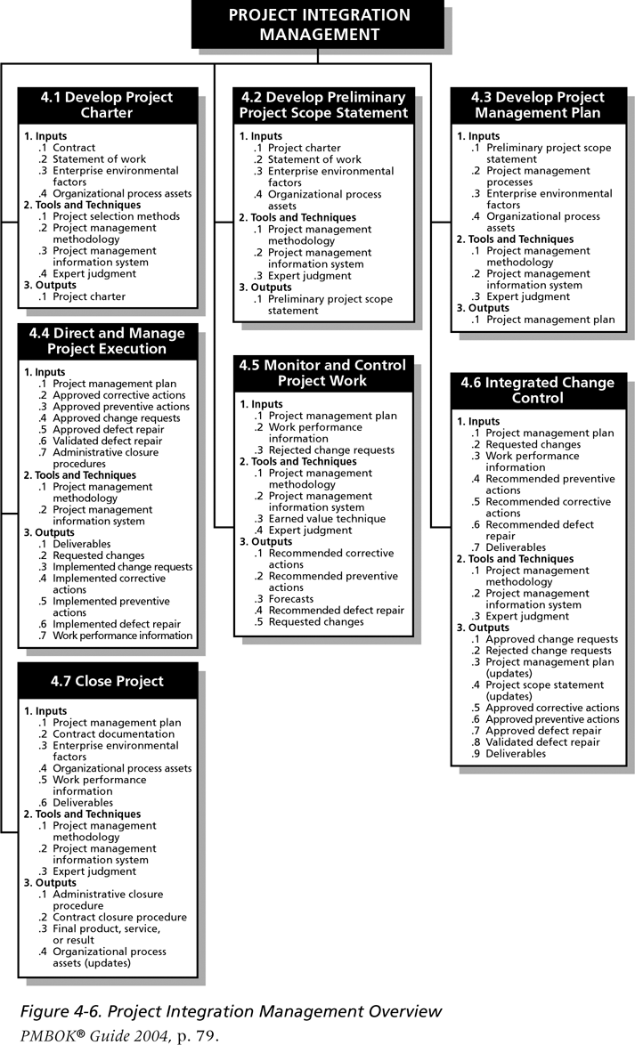
Project Integration Management Overview

Slide 29
Preliminary Scope Statements
A scope statement is a document used to develop and confirm a common understanding of the project scope.
It is an important tool for preventing scope creep:
  The tendency for project scope to keep getting bigger.
A good practice is to develop a preliminary or initial scope statement during project initiation and a more detailed scope statement as the project progresses.

Slide 30
Project Management Plans
A project management plan is a document used to coordinate all project planning documents and help guide a project’s execution and control.
Plans created in the other knowledge areas are subsidiary parts of the overall project management plan.

Slide 31
Attributes of Project Plans
Just as projects are unique, so are project plans.
Plans should be:
  Dynamic
  Flexible
  Updated as changes occur
Plans should first and foremost guide project execution by helping the project manager lead the project team and assess project status.

Slide 32
Common Elements of a Project Management Plan
Introduction or overview of the project.
Description of how the project is organized.
Management and technical processes used on the project.
Work to be done, schedule, and budget information.

Slide 33
Introduction of the Project
The project name
A brief description of the project and the need it addresses
The sponsor’s name
The names of the project manager and key team members
Deliverables of the project
A list of important reference materials
A list of definition and acronyms

Slide 34
Description of How the Project is Organized
Organizational charts
Project responsibilities
Other organizational or process-related information

Slide 35
Management and Technical Processes Used on the Project
Management objectives
Project controls
Risk management
Project staffing
Technical process

Slide 36
Work to be Done
Major work packages
Key deliverables
Other work-related information

Slide 37
Project Schedule
Summary schedule
Detailed schedule
Other schedule-related information

Slide 38
Budget
Summary budget
Detailed budget
Other budget-related information

Slide 39
Stakeholder Analysis
A stakeholder analysis documents important (often sensitive) information about stakeholders such as:
  Stakeholders’ names and organizations.
  Their roles on the project.
  Unique facts about each stakeholder.
  Their level of influence on and interest in the project.
  Suggestions for managing relationships with each stakeholder.

Slide 40
Project Execution
Project execution involves managing and performing the work described in the project management plan.
The majority of time and money is usually spent on execution.
The application area of the project directly affects project execution because the products of the project are produced during project execution.

Slide 41
Project Execution
The project manager need to focus on leading the project team and managing stakeholder relationships to execute the project management plan successfully.
Project human resource management and project communications management are crucial.

Slide 42
Coordinating Planning and Execution
Project planning and execution are intertwined and inseparable activities.
Those who will do the work should help to plan the work.
Project managers must solicit input from the team to develop realistic plans.

Slide 43
Leadership and a Supportive Culture
Project managers must lead by example to demonstrate the importance of creating and then following good project plans.
Organizational culture can help project execution by:
  Providing guidelines and templates.
  Tracking performance based on plans.
Project managers may still need to break the rules to meet project goals, and senior managers must support those actions.

Slide 44
Important Skills for Project Execution
General management skills such as leadership, communication, and political skills.
Product, business, and application area skills and knowledge.
Use of specialized tools and techniques.

Slide 45
Project Execution Tools and Techniques
Project management methodology: Many experienced project managers believe the most effective way to improve project management is to follow a methodology that describes not only what to do in managing a project, but how to do it.
Project management information systems: Hundreds of project management software products are available on the market today, and many organizations are moving toward powerful enterprise project management systems that are accessible via the Internet.
See the “What Went Right?” example of Kuala Lumpur’s Integrated Transport Information System.

Slide 46
Monitoring and Controlling
Project Work
Changes are inevitable on most projects, so it’s important to develop and follow a process to monitor and control changes.
Monitoring project work includes collecting, measuring, and disseminating performance information.
Two important outputs of monitoring and controlling project work include recommended corrective and preventive actions.

Slide 47
Integrated Change Control
Three main objectives are:
  Influence the factors that create changes to ensure that changes are beneficial.
  Determine that a change has occurred.
  Manage actual changes as they occur.
A baseline is the approved project management plan plus approved changes.

Slide 48
Change Control System
A formal, documented process that describes when and how official project documents and work may be changed.
Describes who is authorized to make changes and how to make them.

Slide 49
Change Control Boards (CCBs)
A formal group of people responsible for approving or rejecting changes on a project.
CCBs provide guidelines for preparing change requests, evaluate change requests, and manage the implementation of approved changes.
CCBs include stakeholders from the entire organization.

Slide 50
Making Timely Changes
Some CCBs only meet occasionally, so it may take too long for changes to occur.
Some organizations have policies in place for time-sensitive changes.
  A “48-hour policy” allows project team members to make a decision and have 48 hours to seek approval from top management. If the team decision cannot be implemented, management has 48 hours to reverse a decision; otherwise, the team’s decision is approved.
  Another policy is to delegate changes to the lowest level possible, but keep everyone informed of changes.

Slide 51
Configuration Management
Ensures that the descriptions of the project’s products are correct and complete.
Involves identifying and controlling the functional and physical design characteristics of products and their support documentation.
Configuration management specialists identify and document configuration requirements, control changes, record and report changes, and audit the products to verify conformance to requirements.

Slide 52
What Are These Changes?
changes in
business requirements
changes in
technical requirements
changes in
user requirements
other
documents
software models
Project
Plan
data
Test
code

Slide 53
Closing Projects
To close a project, you must finalize all activities and transfer the completed or cancelled work to the appropriate people.
Main outputs include:
  Administrative closure procedures.
  Contract closure procedures.
  Final products, services, or results.
  Organizational process asset updates.

Slide 54
Using Software to Assist in Project Integration Management
Several types of software can be used to assist in project integration management:
  Word processing software creates documents.
  Presentation software creates presentations.
  Spreadsheets or databases perform tracking.
  Communication software such as e-mail and Web authoring tools facilitate communications.
  Project management software can pull everything together and show detailed and summarized information.

Slide 55
References
“Information Technology Project Management”, Kathy Schwalbe, sixth Edition, THOMSON Course Technology

